Slide 1

IPL WIN PREDICTION
Ankita Dhumal
DATA- Kaggle WEBSITE
ipl-data-set-link

Slide 2

Objective And Synopsis
Problem Definition: IPL Cricket Match Win Prediction Probability. It is a Classification problem.
Problem Statement: The task is to develop a predictive model that accurately predicts the probability of a team winning an IPL cricket match. Given historical match data, the model should be able to estimate the likelihood of a team winning a match.
Dataset: The datasets consists of historical IPL match data (2008-2019), including information about Teams, Players, Venues and the corresponding target variable Match outcomes (win/loss).
The datasets are labeled and includes both numerical and categorical features.
Input: The model will take various input features for a specific match, Batting team, Bowling team, City, Target, Runs left, Balls left, Wickets left, Current runrate, Required runrate, result (Win/lose).
Output: The model will estimate the probability of the teams winning the match.
Evaluation: The model's performance will be evaluated using appropriate evaluation metrics, such as accuracy, precision, recall, and F1 score to assess the accuracy of its predictions.

Slide 3
Problem Definition
Import the Data
Preprocess the Data
Features selection
Exploratory Data Analysis
Split the Train-Test Data
Model building
Steps to Perform a Machine Learning Model
Model Limitation Future Work
Execution
Monitor and Update
Make Prediction
Fine-tune the Model
Evaluate the Model
Train the Model

Slide 4
Data Overview
Datasets:
1. Matches : Each row represents a match played in IPL.
Data consist of 756 No. of matches & 18 features
2. Deliveries : Each row represent a ball played in a match.
Data consist of 179078 No. of deliveries & 21 features
Feature Selection:
Independent variable: batting team, bowling team, city, runs left, balls left, wickets left, total runs, current run rate, required run rate. No. of independent variables are 9
2.Target Variable: dependent variable will be the result of the match i.e Win/lose
Final data base : After performing Data cleaning, EDA and feature selection the no. of variables and features used for model building are final_df (72413 rows × 10 columns)
Operations performed on the data as per requirement are:
1. Group by operation and filtering the data to get total run scored in 2nd inning of each match.
2. Merge operation to get required variables from different data sets.
3. Drop operation to remove non playing teams, DWL matches and incomplete matches.
4. Created new variables current score, runs left, balls left, wickets left, current run rate, required run rate, result.

Slide 5
Preprocessing & Exploratory Data Analysis
Data Inspection: Some important functions used are head(), tail(), info(), describe(), and shape().
Handling Missing Data: To identify missing values, functions used are isnull(), notnull(), and fillna(), unique() to handle missing values by imputing or removing them.
Handling Outliers: Identifying outliers in the data using boxplot plt.boxplot(). Cleaning the dataset by handling outliers or errors in the data using comparative operators.
Input: The model will take various input features for a specific match. Merging and droping of variables as per the requirement.
Data Transformation: Encoding categorical variables using OneHotEncoder. LabelEncoder and get_dummies() function can be used based on the nature of data.
Feature Engineering: Created new features based on existing ones like current_score ,runs_left, balls_left, wickets_left, Current Run Rate(crr = runs/overs), Required Run Rate(rrr = runs left/overs left)

Slide 6
Insights gained from preprocessing
Observations during preprocessing the data:
Missing values:
Winner: Winner was not declared because match was called off in between.
City: All matches were played on Dubai International Cricket Stadium but city is not mentioned.
Delivery: variable is having missing values.
Required run rate: Balls left are 0, therefore rrr value is Nan.
Replacing values:
Teams: Delhi Daredevils replaced by Delhi Capitals, Deccan Chargers replaced by Sunrisers Hyderabad as they are same team
3. Unwanted values:
Teams: Gujarat Lions, Rising Pune Supergiant, Kochi Tuskers Kerala, Kochi Tuskers Kerala are not playing IPL
Total score: To avoid noisy/imperfect data removing matches with DWL.

Slide 7
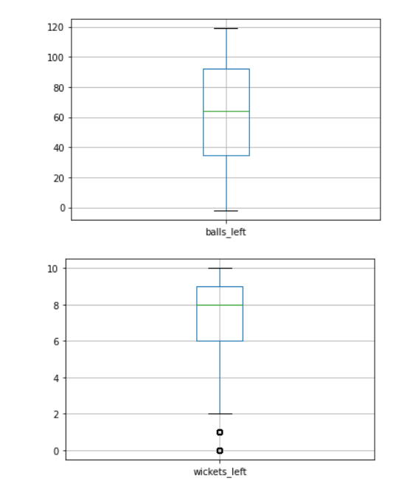
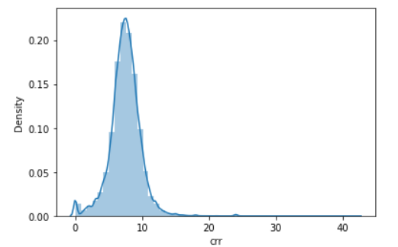
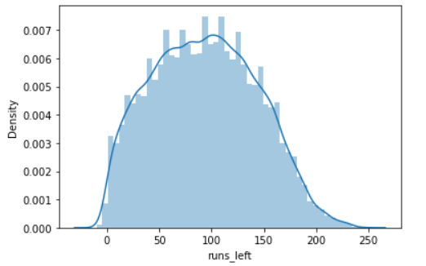
Data Analysis Using Visualization
Boxplot: Identifying outliers in the data using boxplot plt.boxplot()
Outliers are present in balls left, required runrate, current run rate
Distplot: Graph of crr and rrr is skewed beacuse outliers are present in the data.

Slide 8
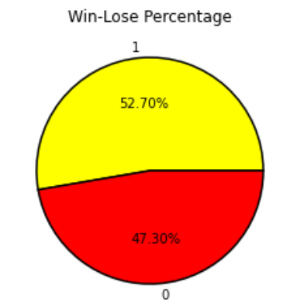
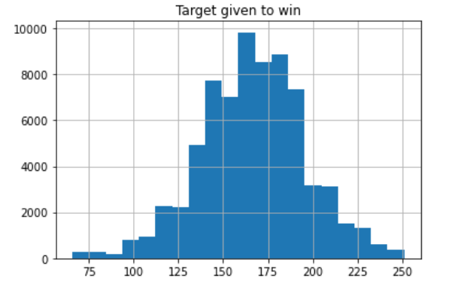
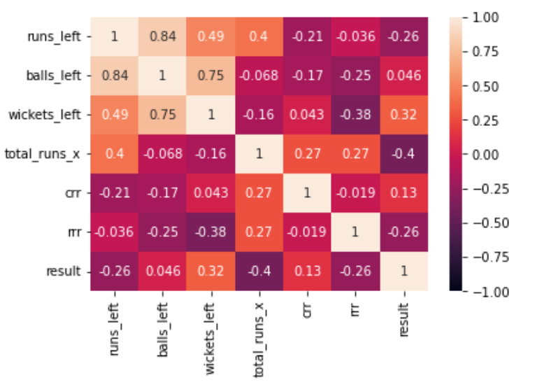
Data Analysis Using Visualization
Pie charts: We have balanced data with categories win and lose.
Histogram: we can conclude that Target given to win is normally distributed. Most of the time target given to chase is between 150 to 200 runs.
Heatmaps: Runs to win always reduces ball after ball.run left can be equal after single ball but cannot increase.
.

Slide 9
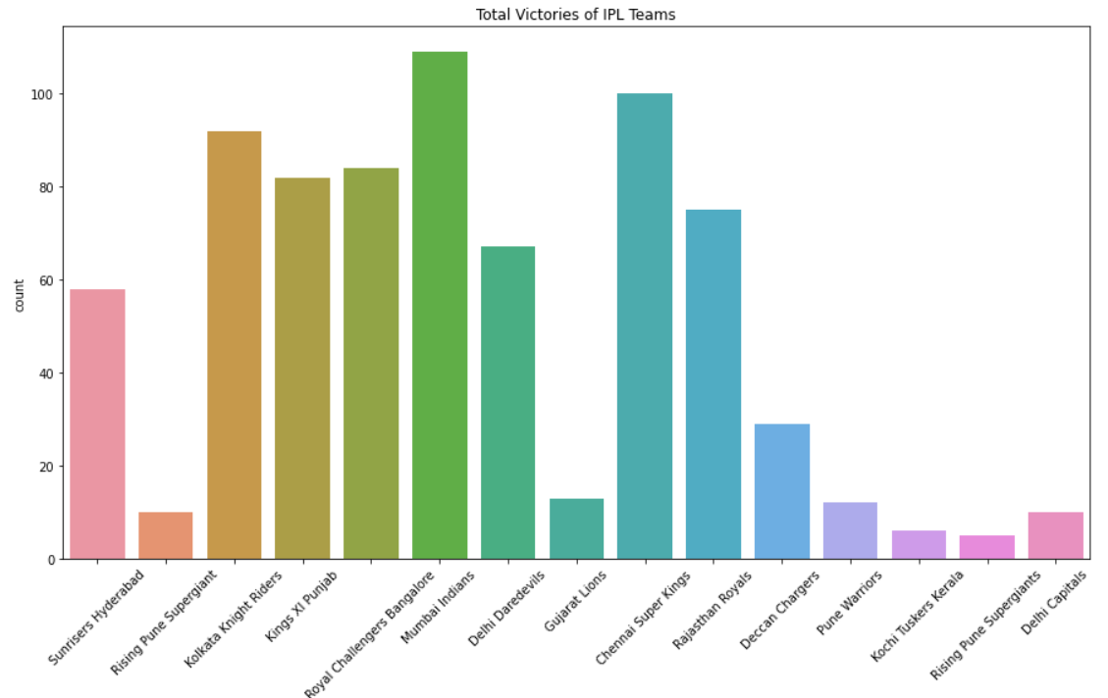
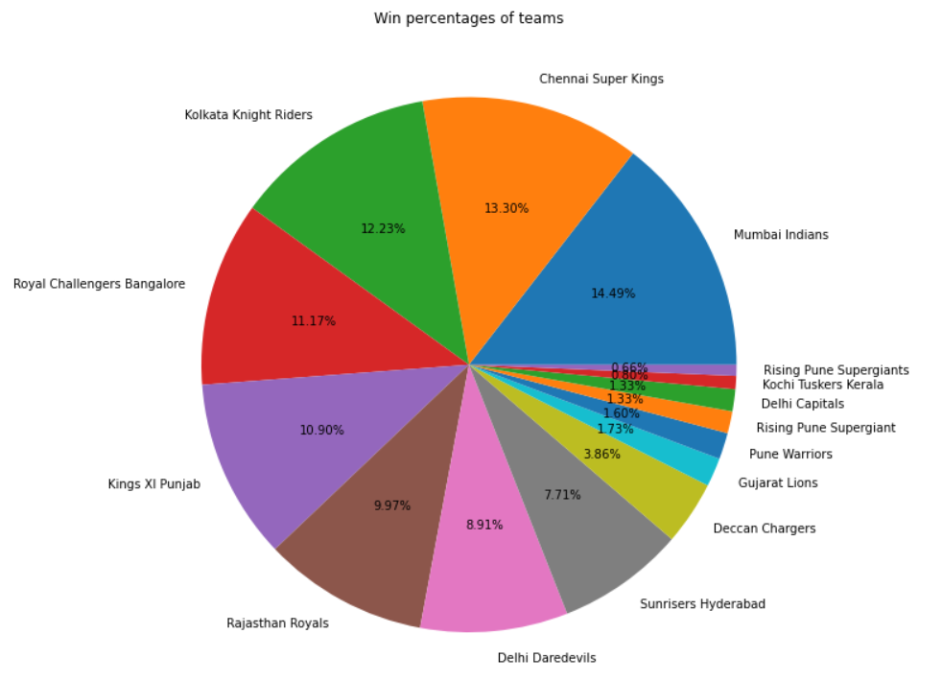
Data Analysis Using Visualization
Count plot: The Mumbai city has hosted the most number of IPL matches-101, followed by Kolkata and Delhi.
Mumbai Indians is the most successful team as they have won the maximum number of IPL matches -109
overall more than 14% matches followed by Chennai Super Kings and Kolkata Knight Riders.

Slide 10
Model Building
This is a CLASSIFICATION PROBLEM but the output required is in the form of probabilities or percentages.
The algorithms which are capable to provide this required results are:
1. Logistic Regression
2. Random forest
3. KNN
Model training and prediction:
Data divided into training and testing by the ratio 80:20% and passthrough a pipeline object
step1 would be transformer that is coverting Categorical values into Numeric using OneHotEncoder
step2 would be model building
Fine-tune the Model :
solver :We have tried different solver='liblinear’ ,'newton-cg', 'lbfgs’, 'sag', 'saga' in pipe resulted in better accuracy score and reduction in Type2 error.
Lowest accuracy score observed was 77% and improved upto 81%
random state: for loop to check value for random state which gives max accuracy

Slide 11
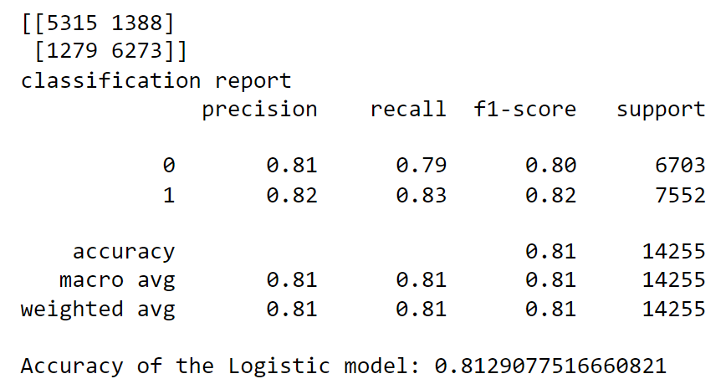
Model Evaluation:
Logistic Regression
Evaluation metrics: accuracy, precision, recall, F1-score
Logistic regression is most suitable for binary classification problems.
It gives the probability of belonging to one of two classes.
it uses sigmoid function which provides a smooth S-shaped curve.
As we are having large no. of data sets, Logistic Regression helps to deal the data effectively.

Slide 12
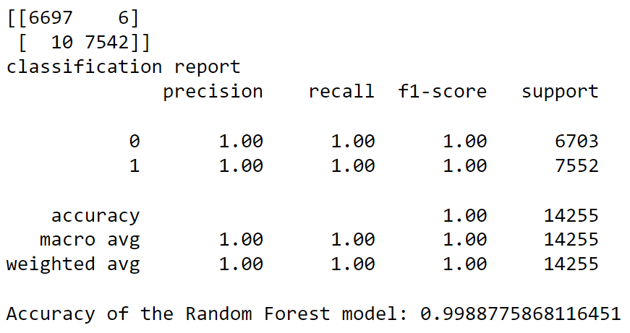
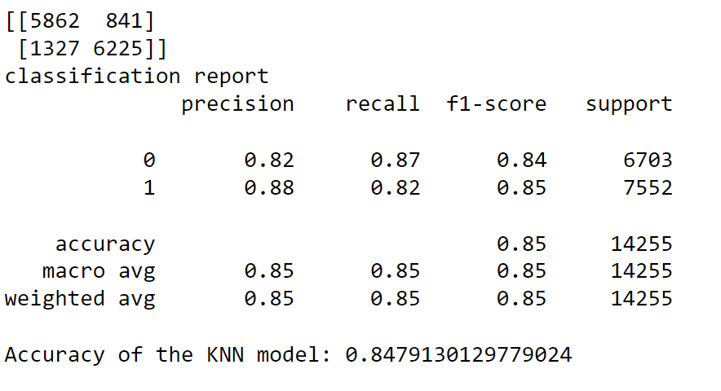
Model Evaluation:
Random Forest:
Reason for not using is Random forest is showing extreme values for probability which are close to 1 or 0
We consider smoothen values so that after every ball probability will not differ drastically.
As we are getting accuracy of 99% ,there are chances of overfitting.
KNN:
When dealing with the large number of observations, Training a KNN model is time-consuming.
It take more time to provide predictions.
As we have more number of observations, KNN is a lazy learner.

Slide 13
Model Limitations and Future Work:
As it is considering overall team performance and not considering individual player’s performance
it may be less accurate if team management makes major changes in players selection.
Need to put limitation in dropdown options that batting team should not be equal to bowling team. Batting team need to be removed from bowling dropdown option
Currently not considering last ball of 20th over because its giving infinity value of required runrate.
Model works for the second inning of matches only. for future improvement can explore advanced modeling techniques so that it can predict for the first inning of the game.
Areas like data collection can be improvised as we have dealt with no. of wrong or misleading data which affects the working of model and ultimately accuracy.

Slide 14
Interpretation For Business
This model is useful for cricket experts and teams to analyze and enhance their performance.
This model will be useful to make strategies against opponent team by knowing winning probability.
Players and management can be more responsible after knowing the importance of wickets by observing the drastic change in winning probability after fall wickets.
This may lead to place more responsible player on crucial position to save wickets.
Sports channels and News channels can use this model to predict the winning probabilities of upcoming game and can broadcast more reliable information in public.

Slide 15
Thank You!

